Slide 1
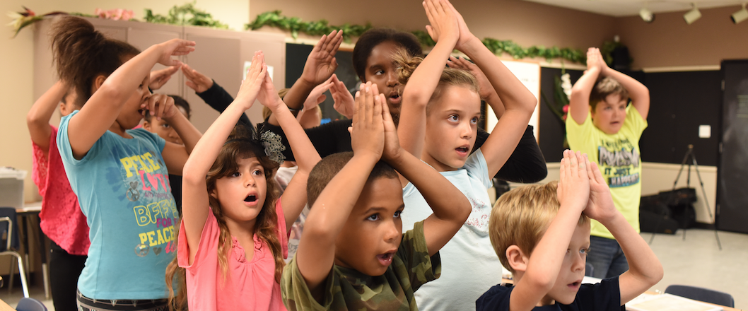
Teaching Science Through VAPA
Jon Schwartz The Rockin’ Teacher
http://rockingteacher.com/

Slide 2
Teaching Science Through VAPA
Introduce & define topic
Materials for teachers so you can use the arts to teach academics
What you need (and don’t need!) to integrate the arts
Origins of my method (discuss what we saw, too, inc. collab)
Theory and research supporting VAPA, video testimony
New VAPA recipe (materials and methods)
How you can do it in your classroom
Free Books and CD’s for some lucky folks!
Questions, How to Contact, Closure

Slide 3
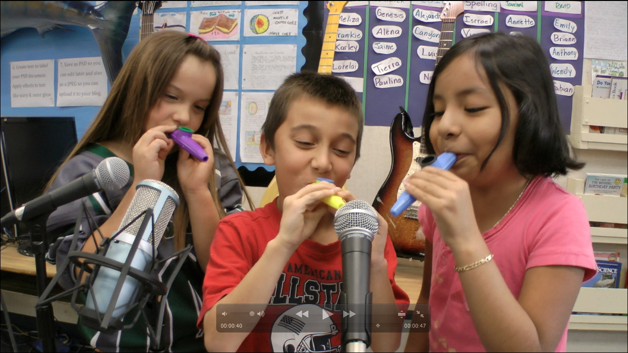
Definition of Arts Integration
Arts integration is teaching academics through singing, music, dance, and visual art.

Slide 4

Arts integration: What you DON’T need
Special musical or arts training
Fancy materials
Money

Slide 5
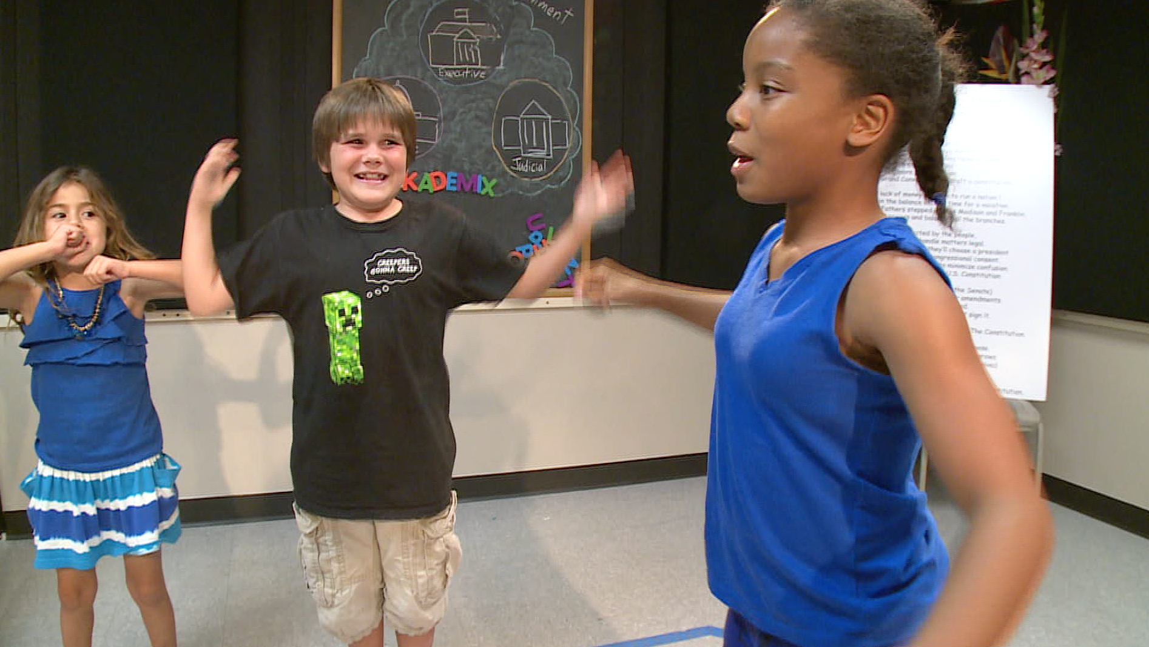
Arts integration: What you DO need
Be OK with you & kids taking risks
Allow students to take the lead
Trust the process & research
See results w/o test scores
Align to standards to get admin & parent buy in

Slide 6

How I stumbled upon VAPA*
My 2012 Class
  ELL & non-English speakers
  Kids reading K-4
  Special needs students
  GATE students
  The “Girl From Japan”
  https://www.youtube.com/watch?v=bDL5M3FCvAY

Slide 7
Recipe and Approach
Use well-chosen songs that can be used to teach standards
  “The Common Core asks students to read stories and literature, as well as more complex texts that provide facts and background knowledge in areas such as science and social studies.” –CCSS http://www.corestandards.org/ELA-Literacy/
  Dance Moves help kids learn kinesthetically
  Art related to song develops fine motor skills and helps visual learners.
  Singing and music reaches auditory learners

Slide 8
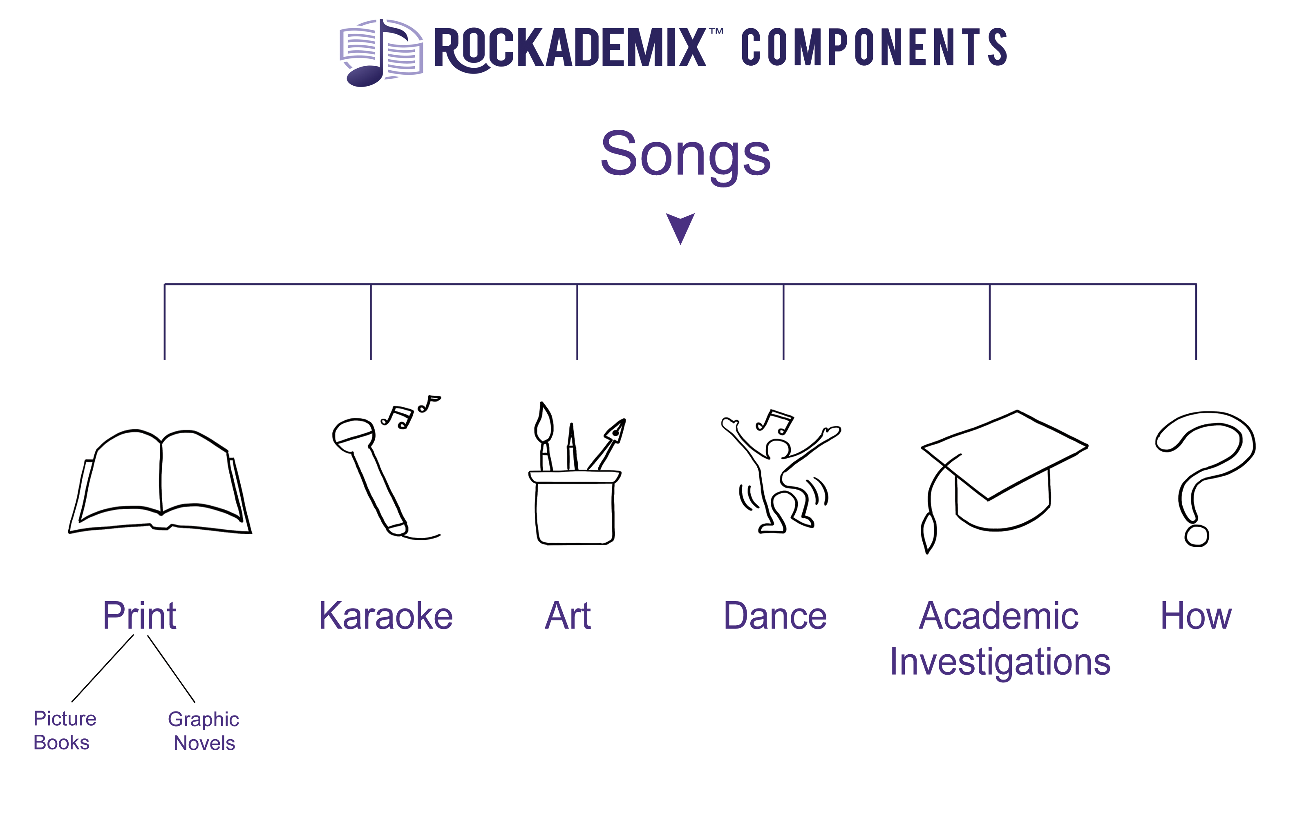

Slide 9
Theory and Research
Multiple Intelligences (Gardner, 1983).
Transfer Effect..arts integration helps students learn academic skills (Petitto, 2008).
Collaboration is found to boost critical thinking skills (Gokhale,1995).
See loads of research in my MA Thesis at http://csusm-dspace.calstate.edu/handle/10211.3/198021

Slide 10

Research on benefits of VAPA
  Readiness to learn
  Academic achievement
  Mood Regulation
  Pride and Motivation
  Neurological Development
  Retention of Information

Slide 11

Why use songs to teach academics?
They are a catchy way to remember lots of information
Singing them & adding dance & art (things adults PAY to do) accesses multiple intelligences.
The CCSS tell us to!

Slide 12

Researched Apollo 13 and wrote “Apollo 13” song

Slide 13
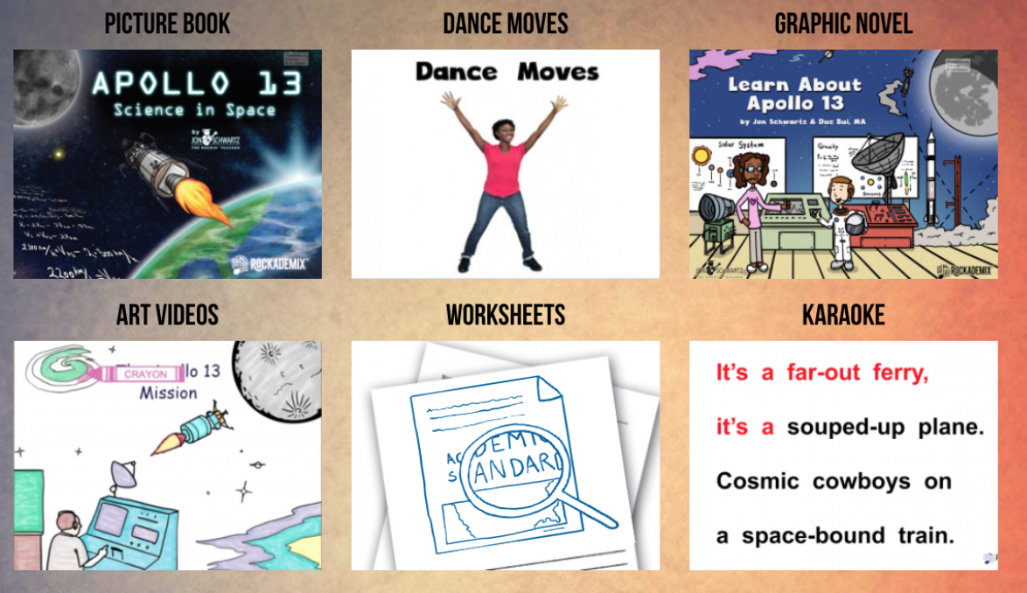
My refined method:
All original material designed to teach Gr. 5 CCSS Science Standards

Slide 14

You Can Do This! *
1. Find some NGSS standards you want to teach.
https://www.nextgenscience.org/search-standards
Gravity…..5-PS2-1 Motion and Stability: Forces and Interactions
Plan and carry out tests to meet constraints of materials, time, and cost…..3-5-ETS1 Engineering Design
Energy in animals’ food is used for body repair…..PS3.D: Energy in Chemical Processes and Everyday Life
2. Find a song that has SOME references to the standards that will help you SUPPLEMENT your teaching of the subject.

Slide 15

Use David Bowie’s “Space Oddity” to Teach 5th Grade NGSS
Video with lyrics https://youtu.be/9_M3uw29U1U
Ground Control to Major Tom
Take your protein pills and put your helmet on
(Energy in food is used for body repair)
"This is Major Tom to Ground Control
I'm stepping through the door
And I'm floating in a most peculiar way
(Gravity)
Ground Control to Major Tom
Your circuit's dead, there's something wrong
Can you hear me major Tom?
(Plan and carry out tests to meet
constraints of materials, time, and cost)
Full lyrics
https://www.google.com/search?q=space+oddity+lyrics&source=lnms&sa=X&ved=0ahUKEwia7rLCpebXAhWHxlQKHZOPCtcQ_AUICSgA&biw=1172&bih=705&dpr=1.75

Slide 16
Jon Schwartz’s Rockin’ Teacher Website
For any questions or more information, email or call me, and please follow me on:
Facebook https://www.facebook.com/therockingteacher
Twitter https://twitter.com/TeacherJonRox
LinkedIn https://www.linkedin.com/in/jon-schwartz-9472ba9
Thanks so much again for attending!
Jon Schwartz
http://rockingteacher.com
jon@rockingteacher.com
760-712-7778

