Slide 1
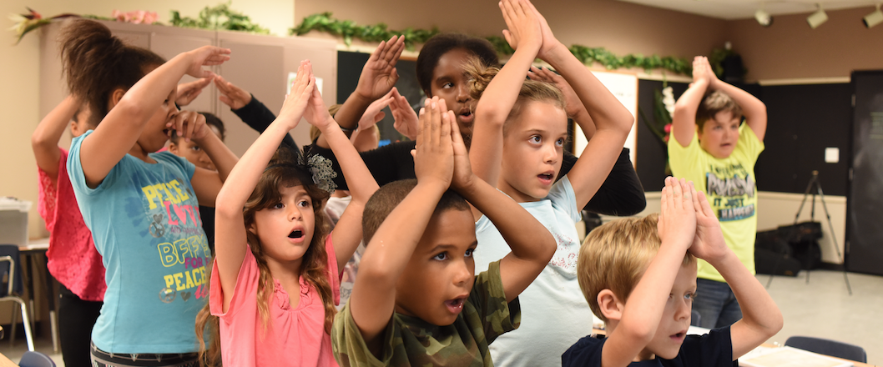
Teaching Science Through VAPA
Jon Schwartz The Rockin’ Teacher
http://rockingteacher.com/

Slide 2
Teaching Science Through VAPA
Introduce & define topic Go to rockingteacher.com/nsta
Materials for teachers so you can use the arts to teach academics
What you need (and don’t need!) to integrate the arts
Origins of my method (discuss what we saw, too, inc. collab)
Theory and research supporting VAPA, video testimony
New VAPA recipe (materials and methods)
How you can do it in your classroom
Free Books and CD’s for some lucky folks!
Questions, How to Contact, Closure

Slide 3
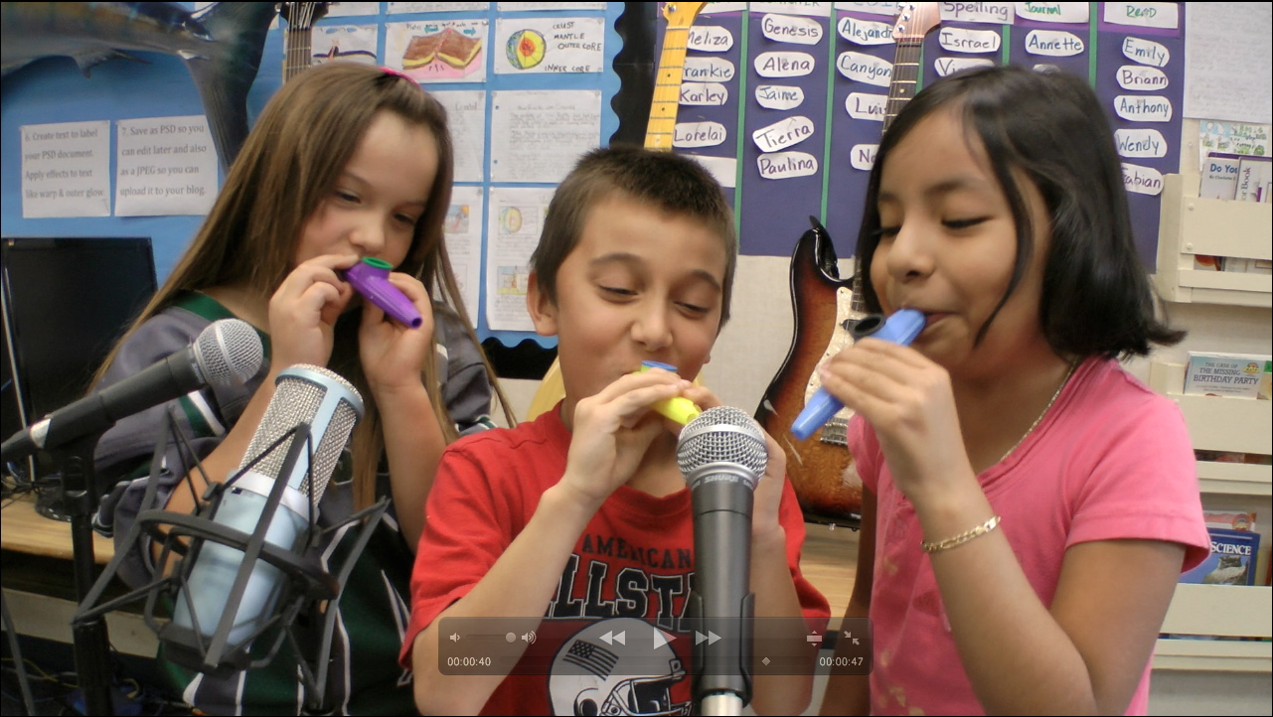
Definition of Arts Integration
Arts integration is teaching academics through singing, music, dance, and visual art.

Slide 4

Arts integration: What you DON’T need
Special musical or arts training
Fancy materials
Money

Slide 5
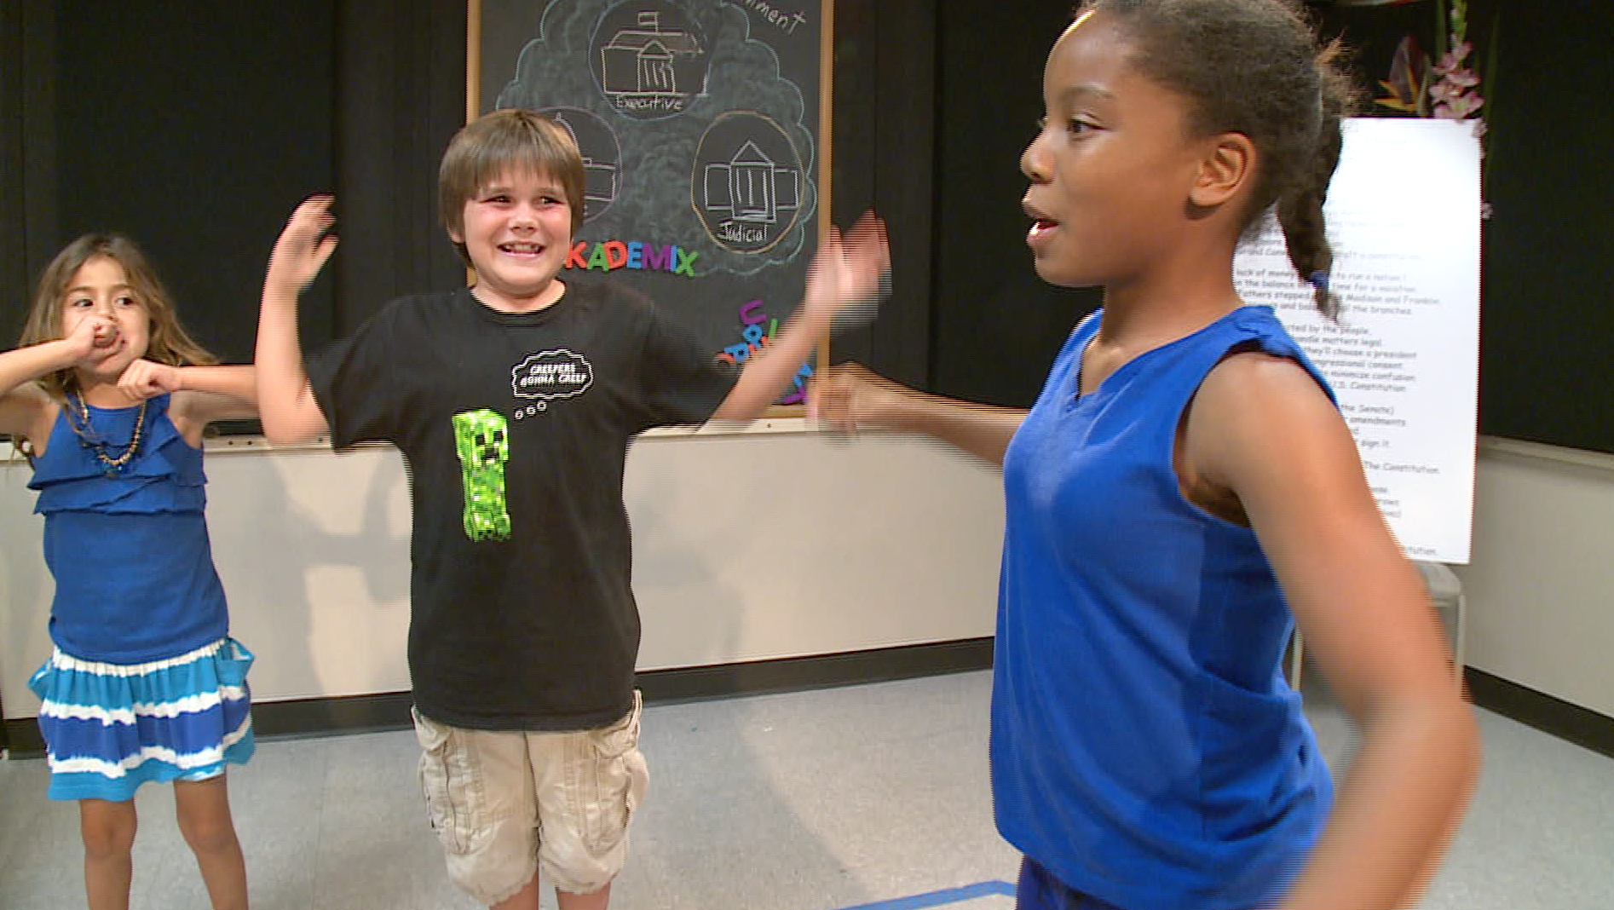
Arts integration: What you DO need
Be OK with you & kids taking risks
Allow students to take the lead
Trust the process & research
See results w/o test scores
Align to standards to get admin & parent buy in

Slide 6

How I stumbled upon VAPA*
My 2012 Class
ELL & non-English speakers
Kids reading K-4
Special needs students
GATE students
The “Girl From Japan”
https://www.youtube.com/watch?v=bDL5M3FCvAY

Slide 7
Recipe
Use well-chosen songs that can be used to teach standards
“The Common Core asks students to read stories and literature, as well as more complex texts that provide facts and background knowledge in areas such as science and social studies.” –CCSS http://www.corestandards.org/ELA-Literacy/
Dance Moves help kids learn kinesthetically
Art related to song develops fine motor skills and helps visual learners.
Singing and music reaches auditory learners

Slide 8
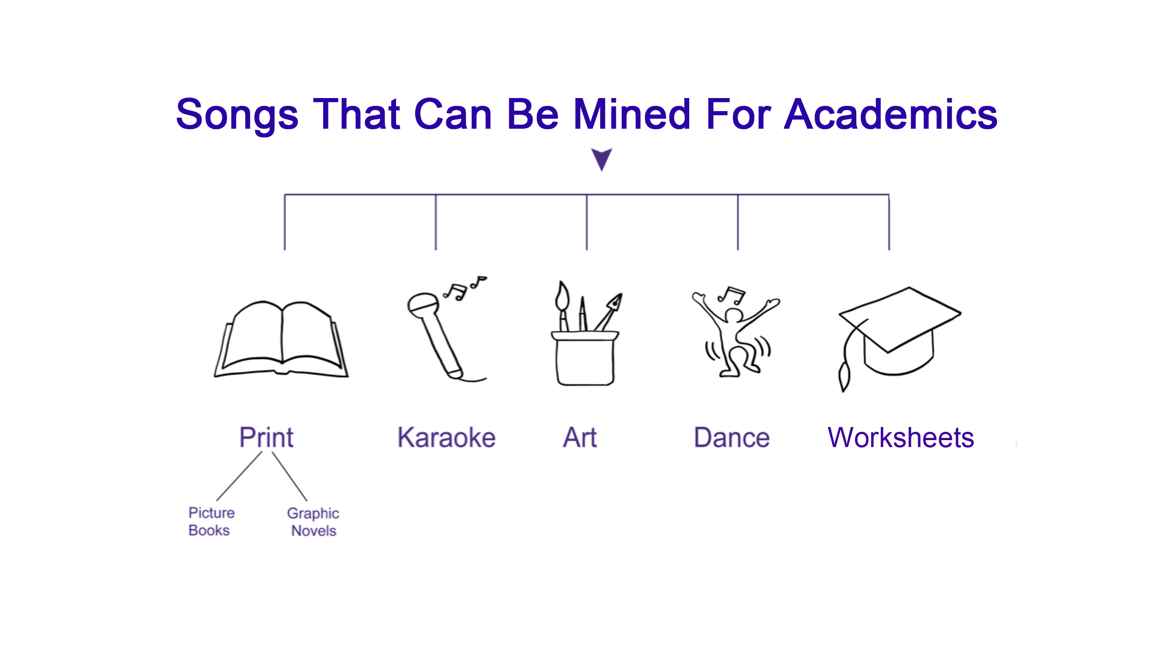

Slide 9
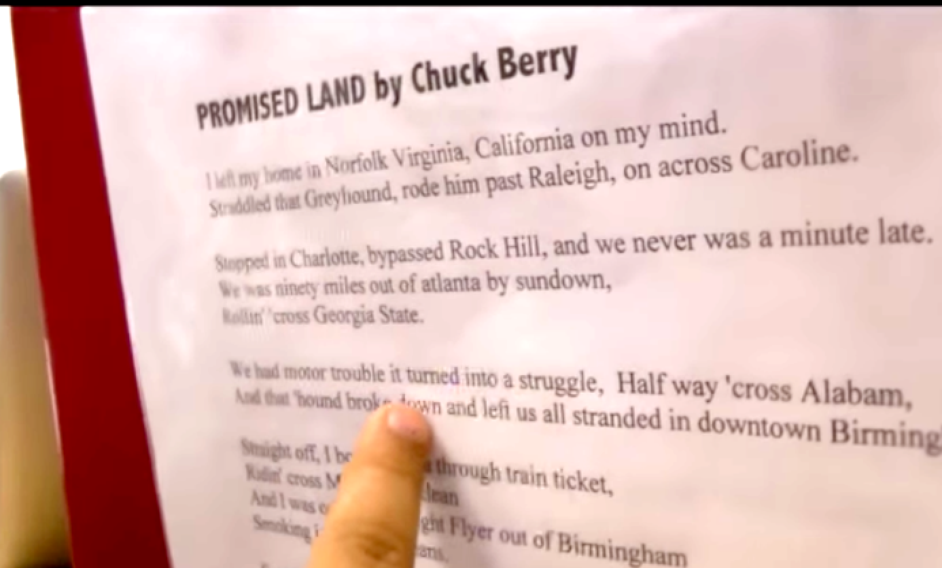
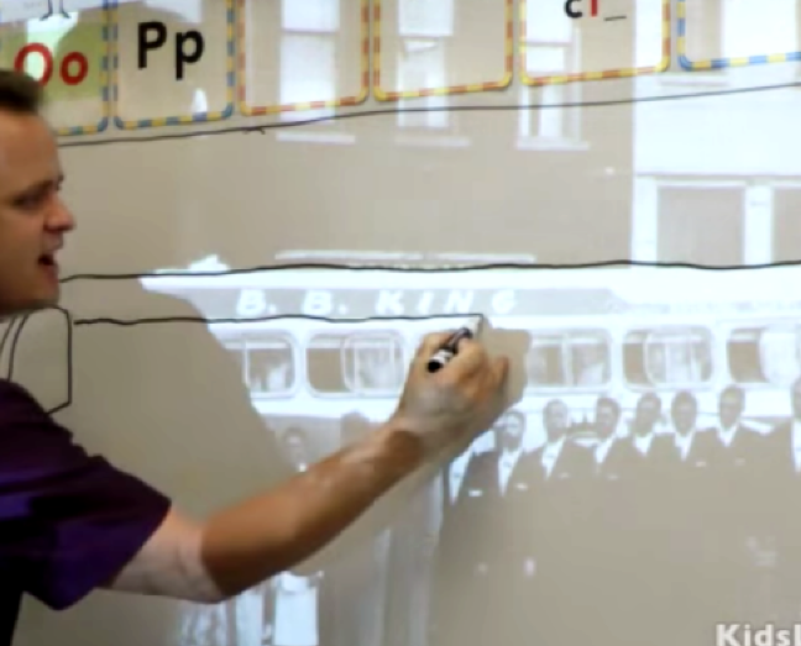
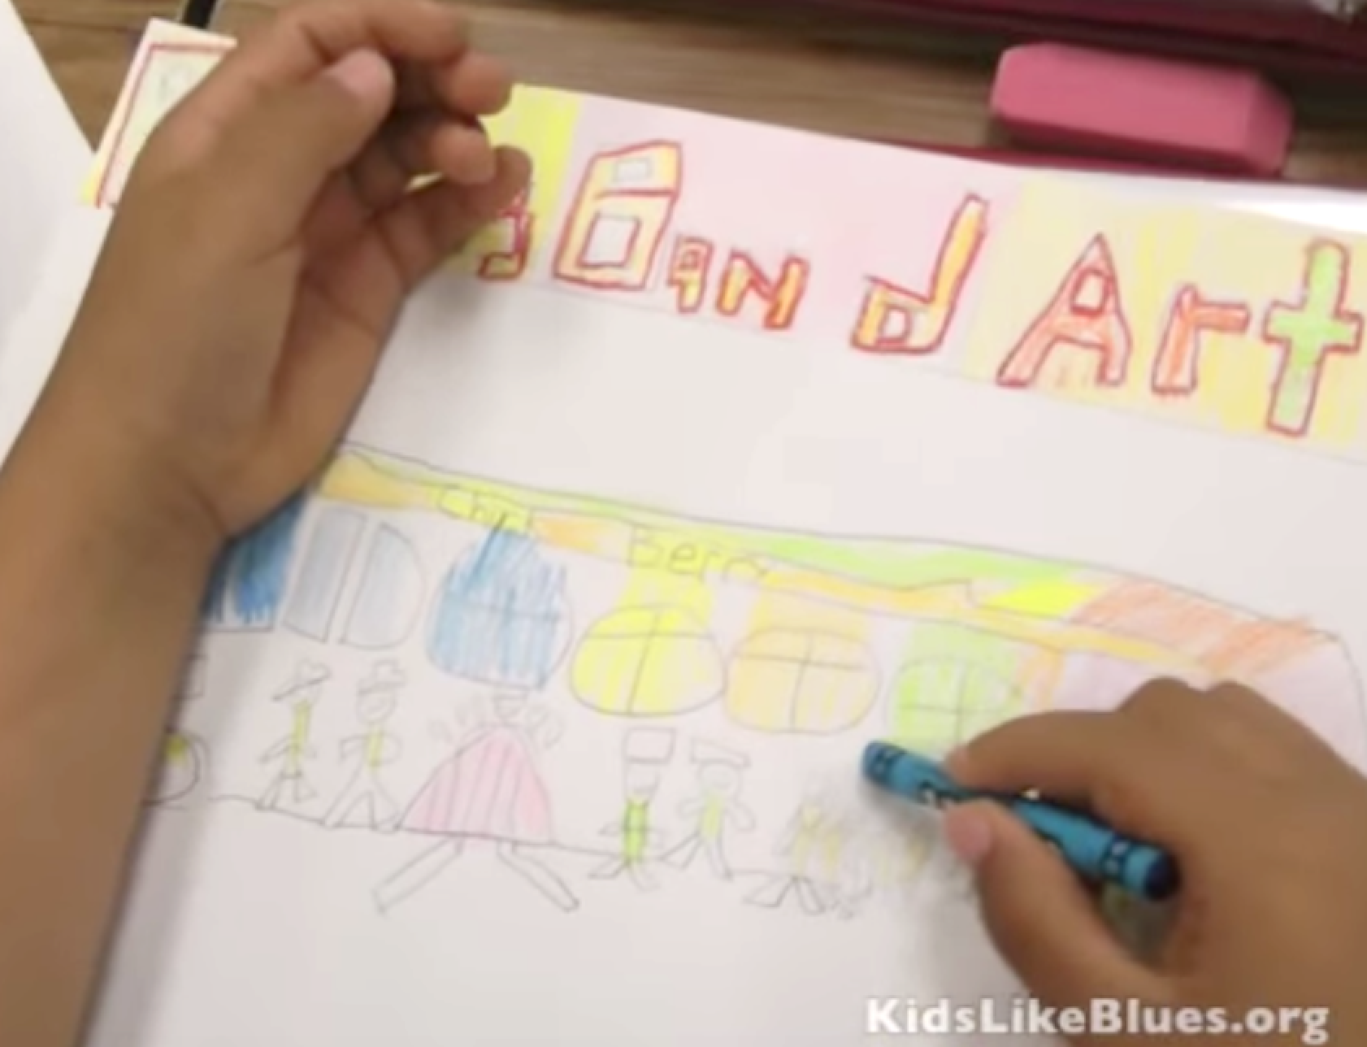
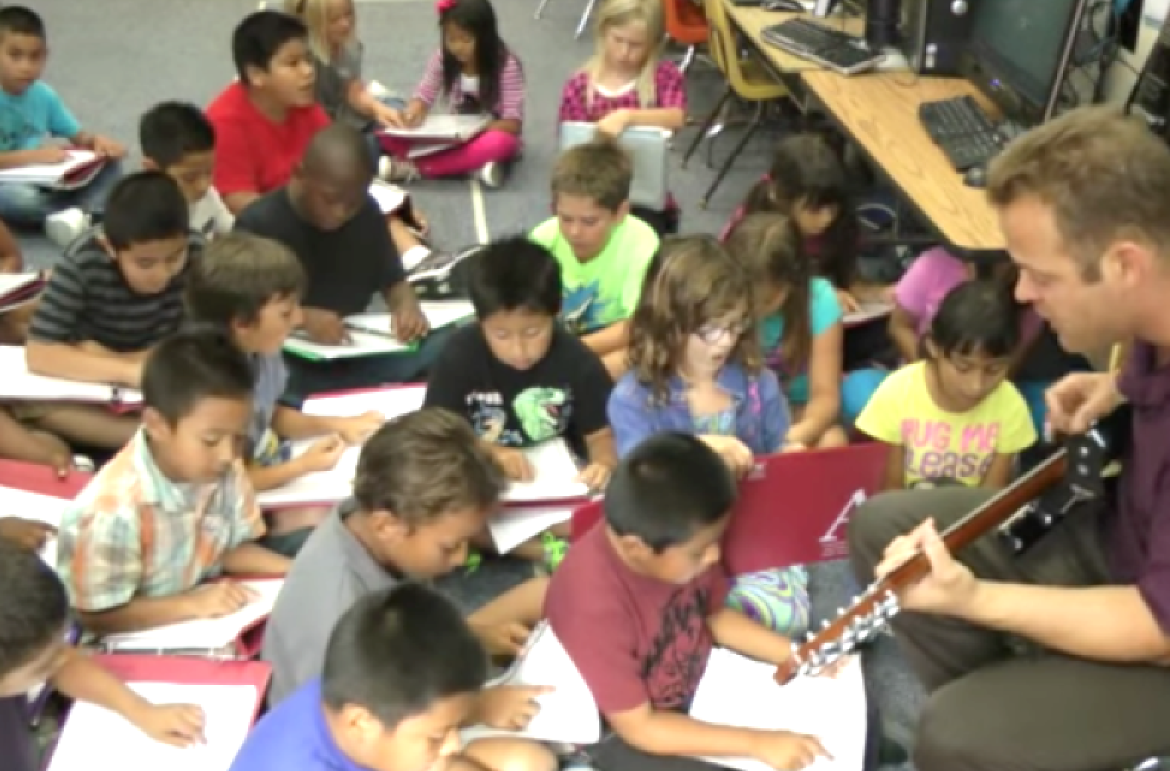
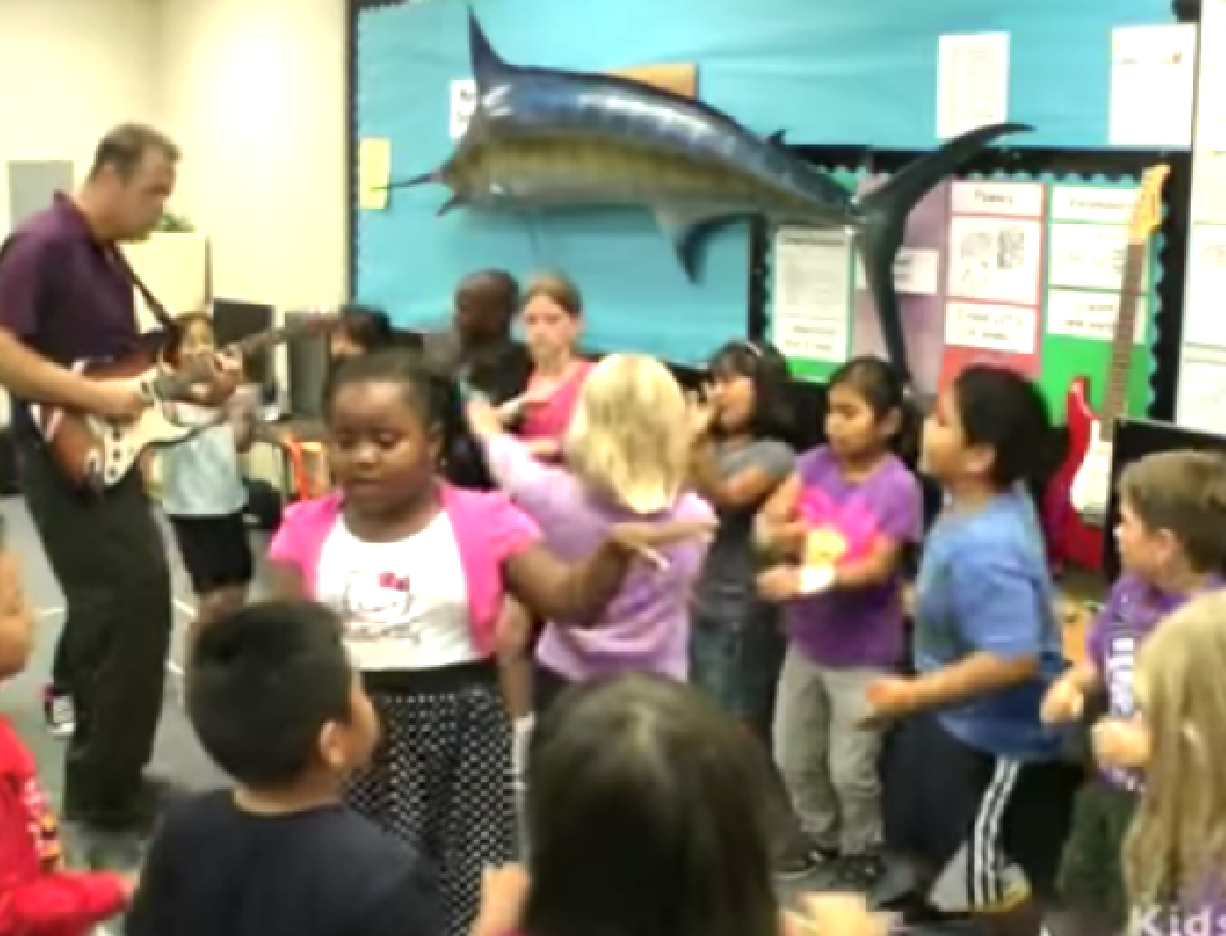

Slide 10
Theory and Research
Multiple Intelligences (Gardner, 1983).
Transfer Effect..arts integration helps students learn academic skills (Petitto, 2008).
Collaboration is found to boost critical thinking skills (Gokhale,1995).
See loads of research in my MA Thesis at http://csusm-dspace.calstate.edu/handle/10211.3/198021

Slide 11
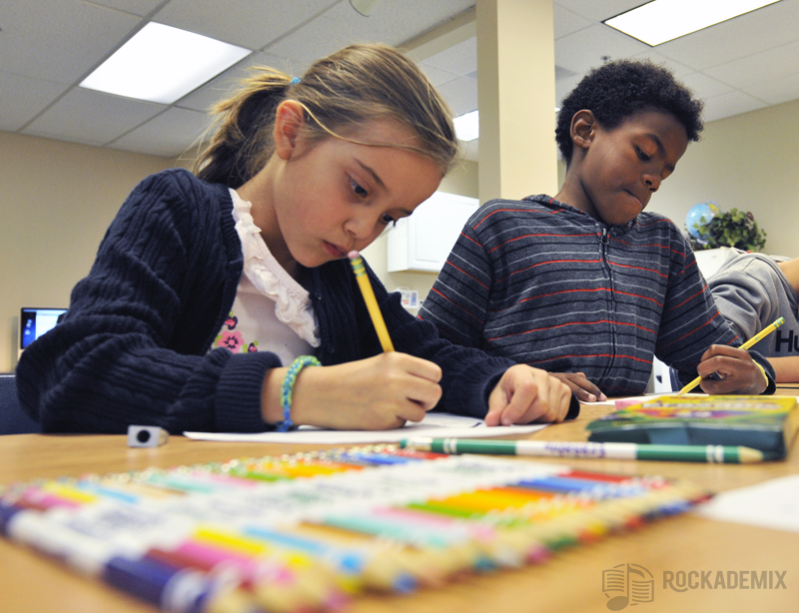
Research on benefits of VAPA
Readiness to learn
Academic achievement
Mood Regulation
Pride and Motivation
Neurological Development
Retention of Information

Slide 12

Why use songs to teach academics?
They are a catchy way to remember lots of information
Singing them & adding dance & art (things adults PAY to do) accesses multiple intelligences.
The CCSS tell us to!

Slide 13
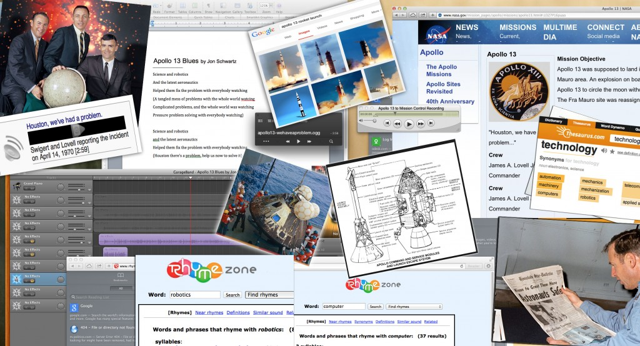
Researched Apollo 13, wrote “Apollo 13” song

Slide 14
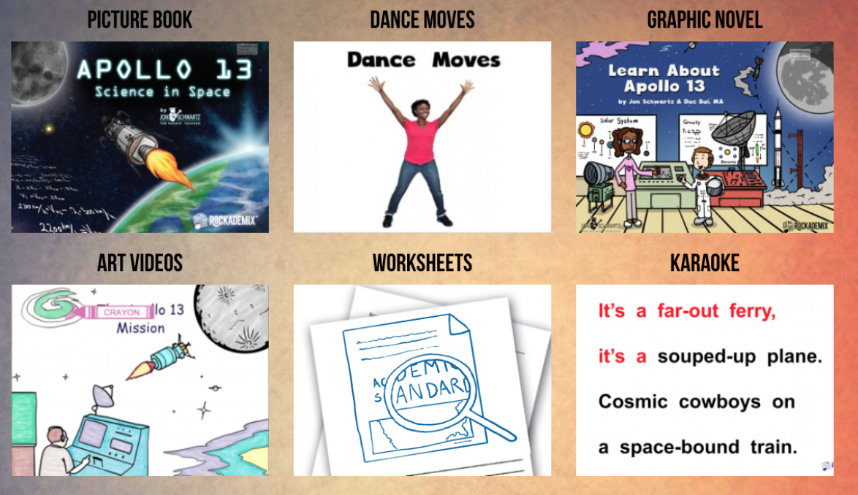
My refined method: (See on Website)
All original material designed to teach Gr. 5 CCSS Science Standards

Slide 15
Apollo 13
Houston there’s a problem, we just heard a rumble
Quick, check the voltage, and button up the tunnel
A jolt rocked the sensor, the temperatures unstable
Check the cabin pressure, and fasten up the cables
Science and robotics and the latest aeronautics
Helped them fix the problem with everybody watching

Slide 16
Apollo 13
It’s a far out ferry, it’s a souped-up plane
Cosmic cowboys on a space-bound train
Liquid filled fuel tanks, pushing 60 tons
A quarter-million miles from the 3rd stone from the sun
The seventh manned mission flying to the moon
Sent to see a crater in a rocketship cocoon

Slide 17

You Can Do This! *
1. Find some NGSS standards you want to teach.
https://www.nextgenscience.org/search-standards
Gravity…..5-PS2-1 Motion and Stability: Forces and Interactions
Plan and carry out tests to meet constraints of materials, time, and cost…..3-5-ETS1 Engineering Design
Energy in animals’ food is used for body repair…..PS3.D: Energy in Chemical Processes and Everyday Life
2. Find a song that has SOME references to the standards that will help you SUPPLEMENT your teaching of the subject.

Slide 18
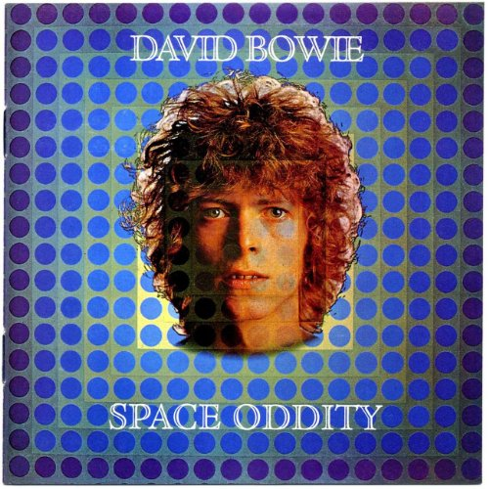
Use David Bowie’s “Space Oddity” to Teach 5th Grade NGSS
Video with lyrics https://youtu.be/9_M3uw29U1U
Ground Control to Major Tom Take your protein pills, put your helmet on
(Energy in food is used for body repair)
"This is Major Tom to Ground Control I'm stepping through the door And I'm floating in a most peculiar way
(Gravity)
Ground Control to Major Tom Your circuit's dead, there's something wrong
Can you hear me major Tom?
(Plan and carry out tests to meet
constraints of materials, time, and cost)
Full lyrics
https://www.google.com/search?q=space+oddity+lyrics&source=lnms&sa=X&ved=0ahUKEwia7rLCpebXAhWHxlQKHZOPCtcQ_AUICSgA&biw=1172&bih=705&dpr=1.75

Slide 19
Jon Schwartz’s Rockin’ Teacher Website
For any questions or more information, email or call me, and please follow me on:
Facebook https://www.facebook.com/therockingteacher
Twitter https://twitter.com/TeacherJonRox
LinkedIn https://www.linkedin.com/in/jon-schwartz-9472ba9
Thanks so much again for attending!
Jon Schwartz
http://rockingteacher.com
jon@rockingteacher.com
760-712-7778

