Slide 1
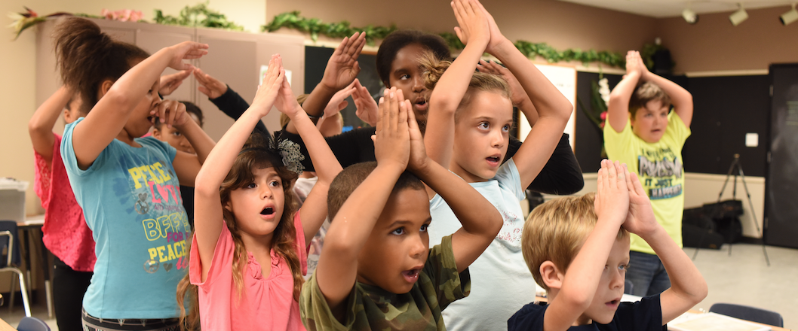
Teaching Science Through VAPA
Jon Schwartz The Rockin’ Teacher
http://rockingteacher.com/

Slide 2
Teaching Science Through VAPA
Introduce & define topic Go to rockingteacher.com/nsta
Materials for teachers so you can use the arts to teach academics
What you need (and don’t need!) to integrate the arts
Origins of my method (discuss what we saw, too, inc. collab)
Theory and research supporting VAPA, video testimony
New VAPA recipe (materials and methods)
How you can do it in your classroom
Free Books and CD’s for some lucky folks!
Questions, How to Contact, Closure

Slide 3
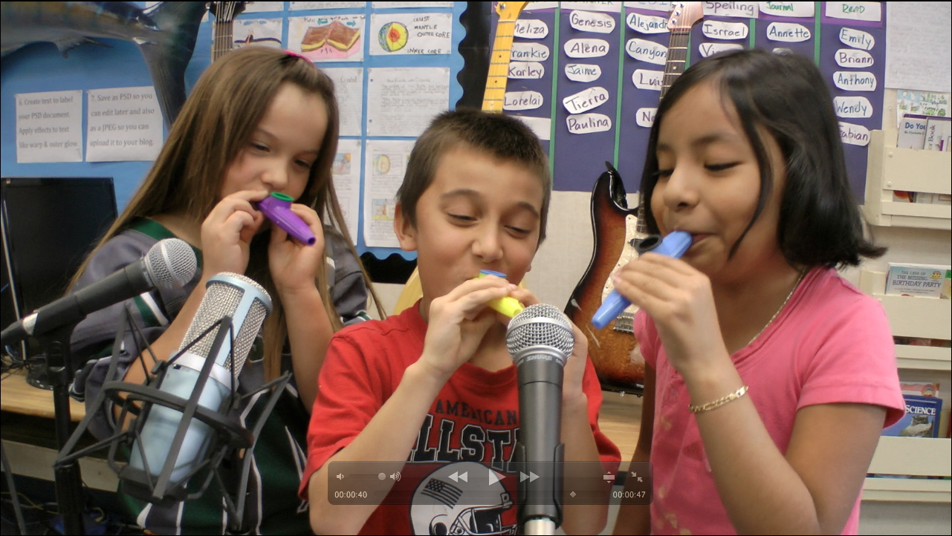
Definition of Arts Integration
Arts integration is teaching academics through singing, music, dance, and visual art.

Slide 4
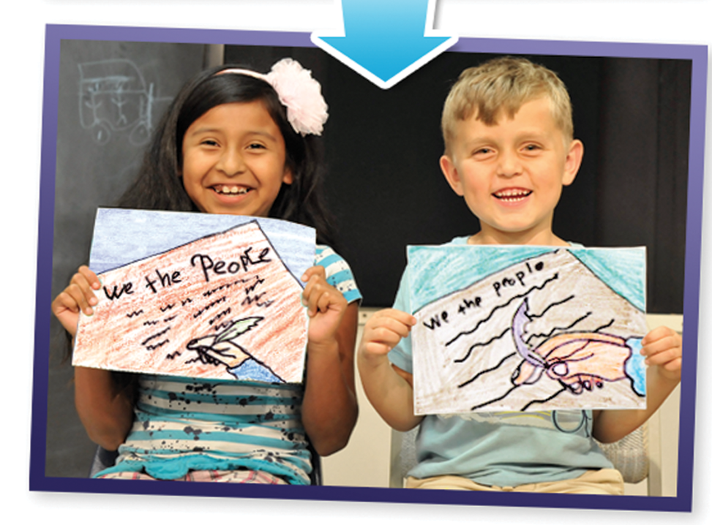
Arts integration: What you DON’T need
Special musical or arts training
Fancy materials
Money

Slide 5
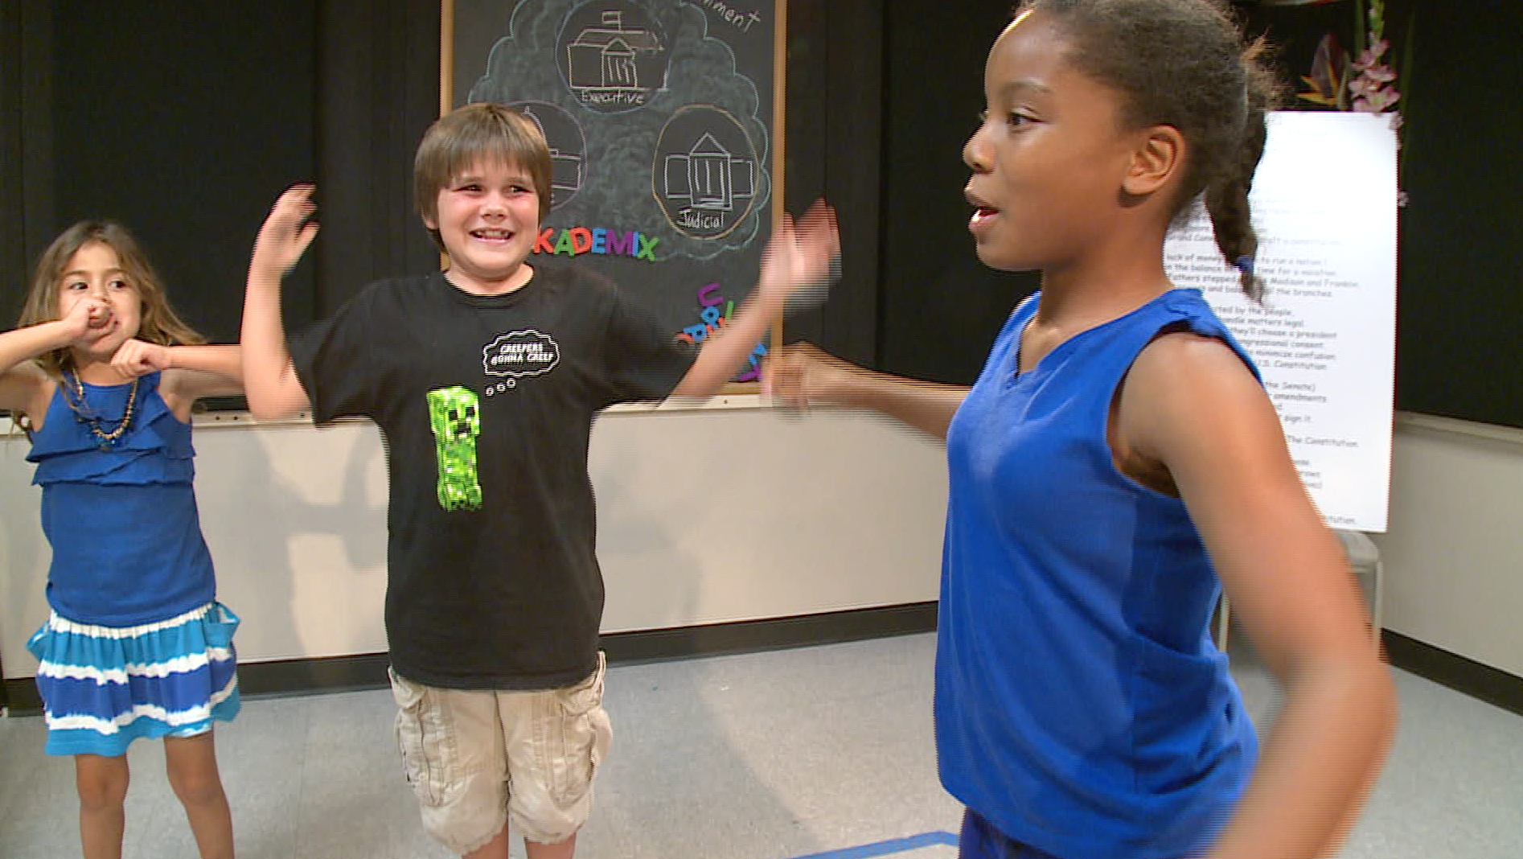
Arts integration: What you DO need
Be OK with you & kids taking risks
Allow students to take the lead
Trust the process & research
See results w/o test scores
Align to standards to get admin & parent buy in

Slide 6
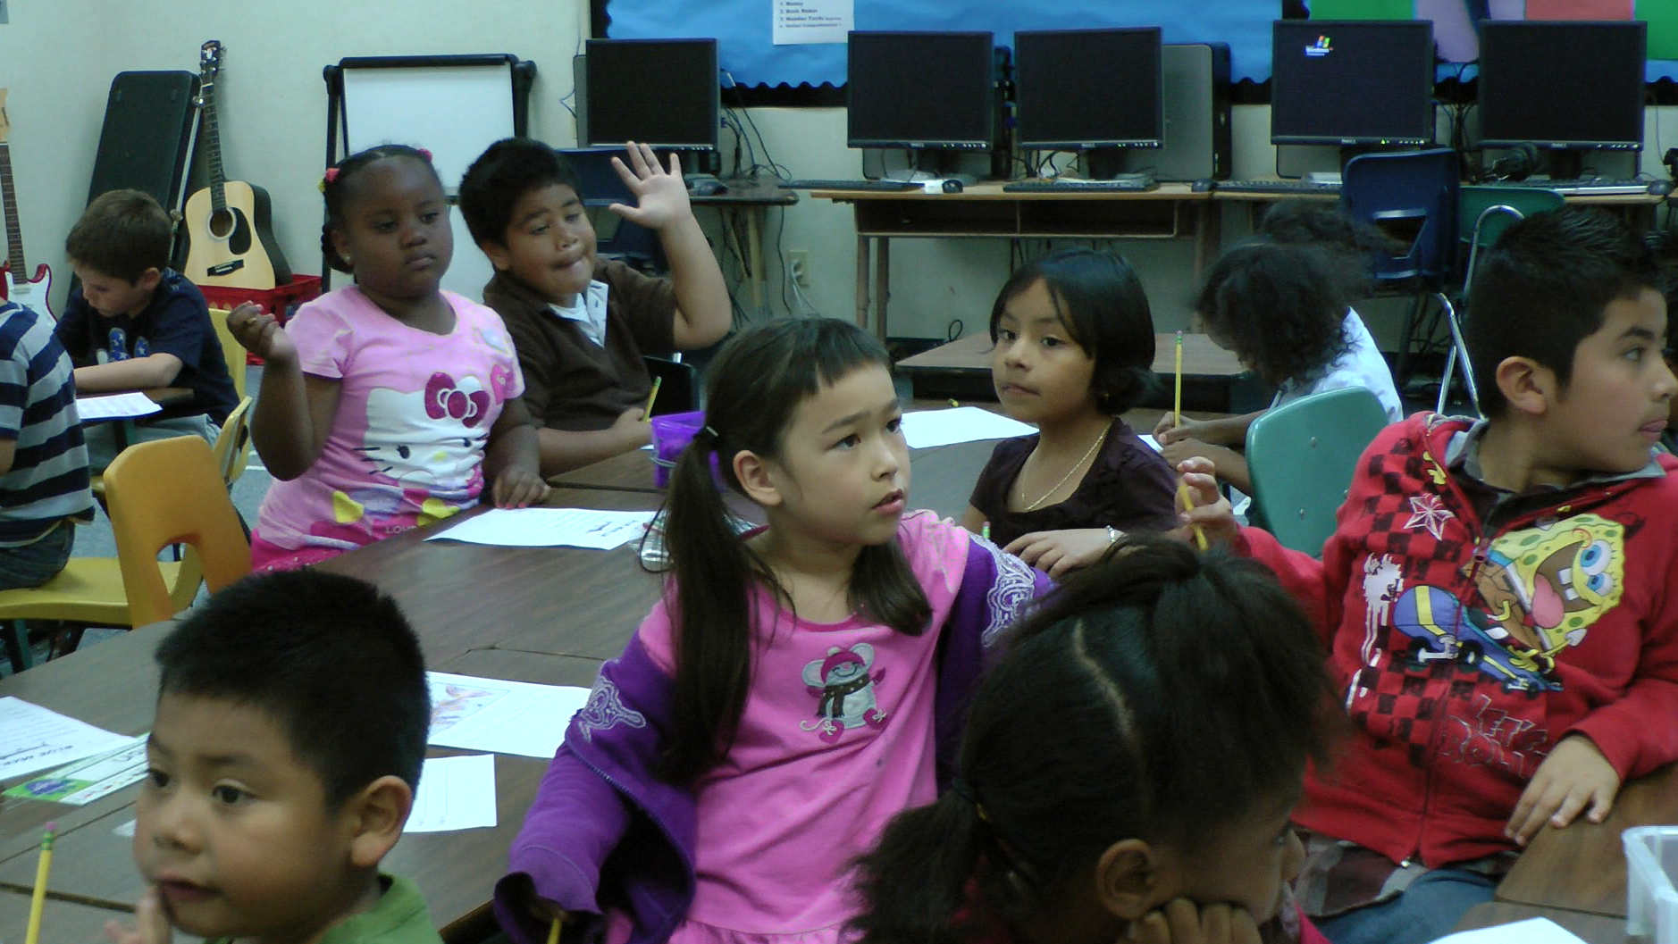
How I stumbled upon VAPA*
My 2012 Class
  ELL & non-English speakers
  Kids reading K-4
  Special needs students
  GATE students
  The “Girl From Japan”
  https://www.youtube.com/watch?v=bDL5M3FCvAY

Slide 7
Our Recipe
Use well-chosen songs that can be used to teach standards
  “The Common Core asks students to read stories and literature, as well as more complex texts that provide facts and background knowledge in areas such as science and social studies.” –CCSS http://www.corestandards.org/ELA-Literacy/
  Dance Moves help kids learn kinesthetically
  Art related to song develops fine motor skills and helps visual learners.
  Singing and music reaches auditory learners

Slide 8
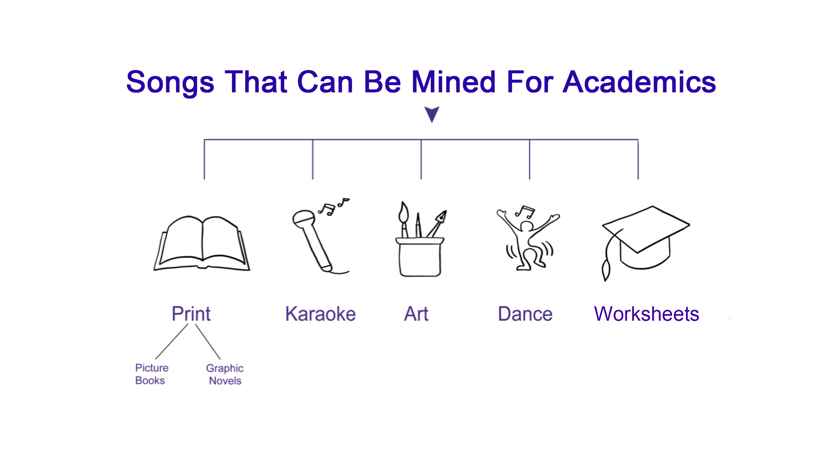

Slide 9
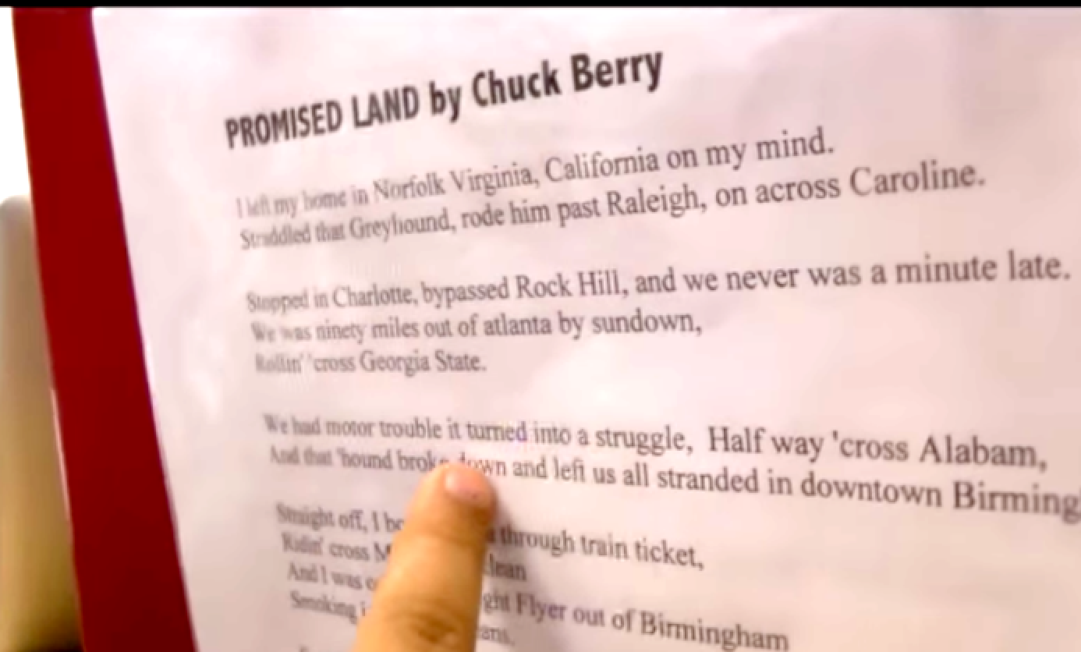
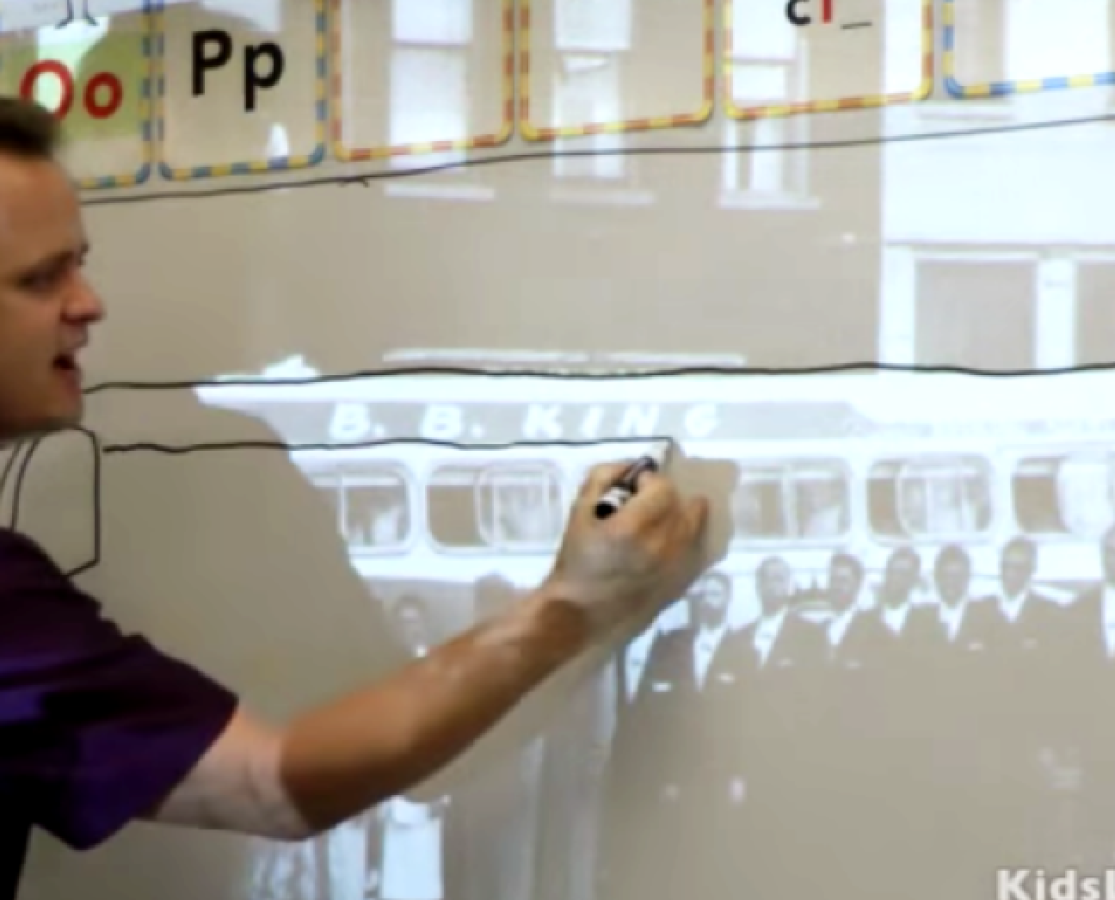
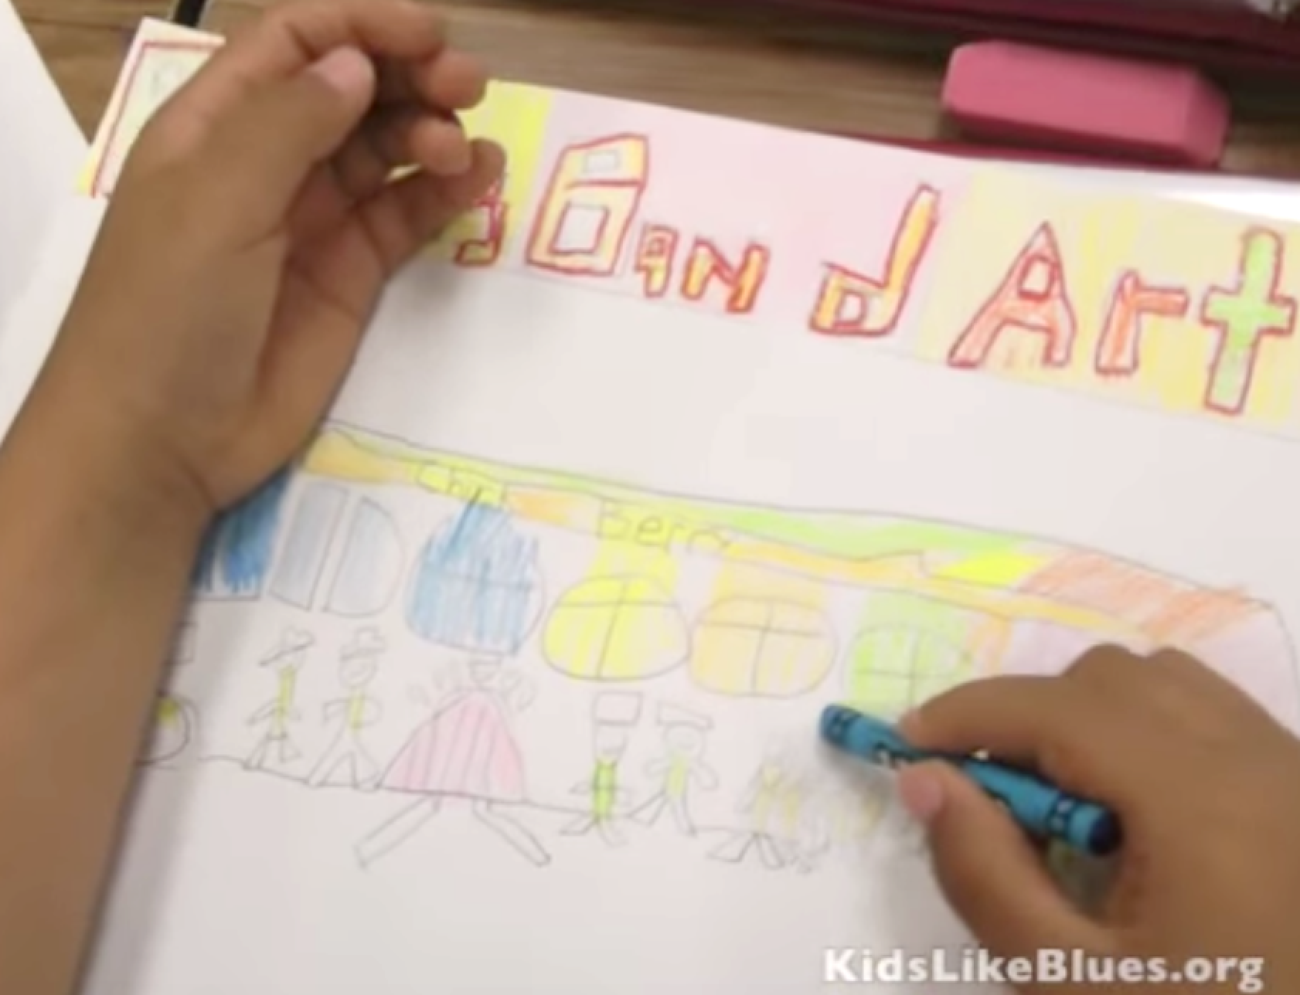
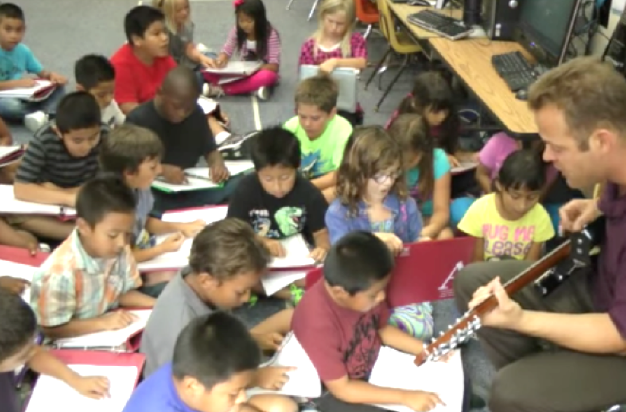
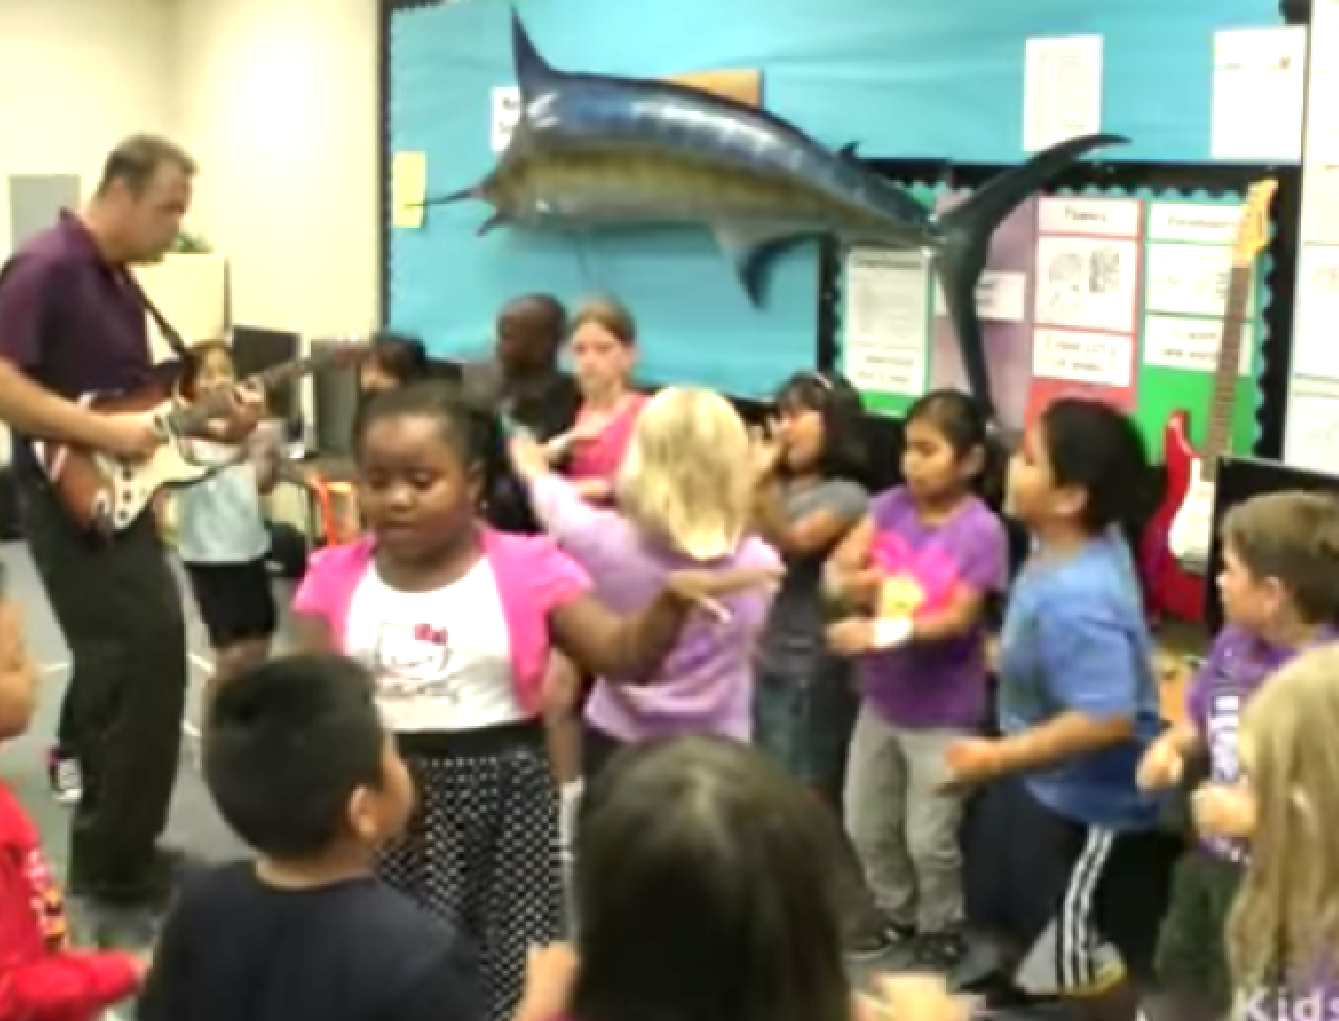
Recipe

Slide 10
Theory and Research
Multiple Intelligences (Gardner, 1983).
Transfer Effect..arts integration helps students learn academic skills (Petitto, 2008).
Collaboration is found to boost critical thinking skills (Gokhale,1995).
See loads of research in my MA Thesis at http://csusm-dspace.calstate.edu/handle/10211.3/198021

Slide 11
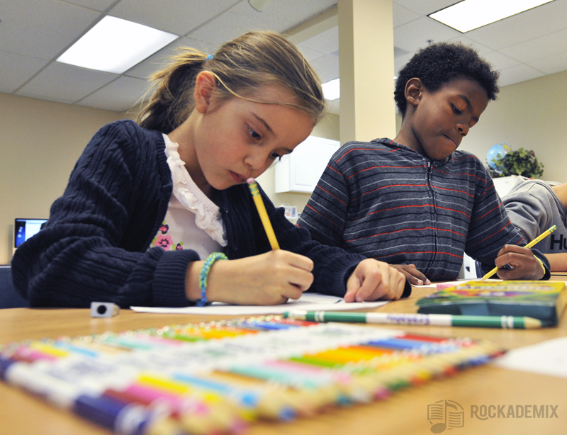
Research on benefits of VAPA
  Readiness to learn
  Academic achievement
  Mood Regulation
  Pride and Motivation
  Neurological Development
  Retention of Information

Slide 12

Why use songs to teach academics?
They are a catchy way to remember lots of information
Singing them & adding dance & art (things adults PAY to do) accesses multiple intelligences.
The CCSS tell us to!

Slide 13
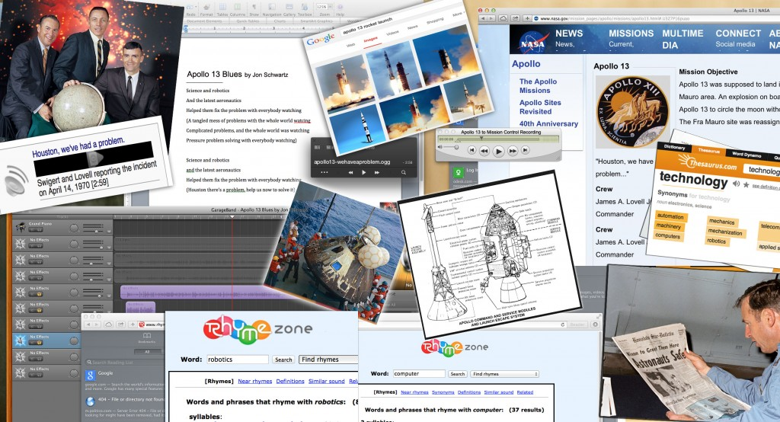
Researched Apollo 13, wrote “Apollo 13” song

Slide 14
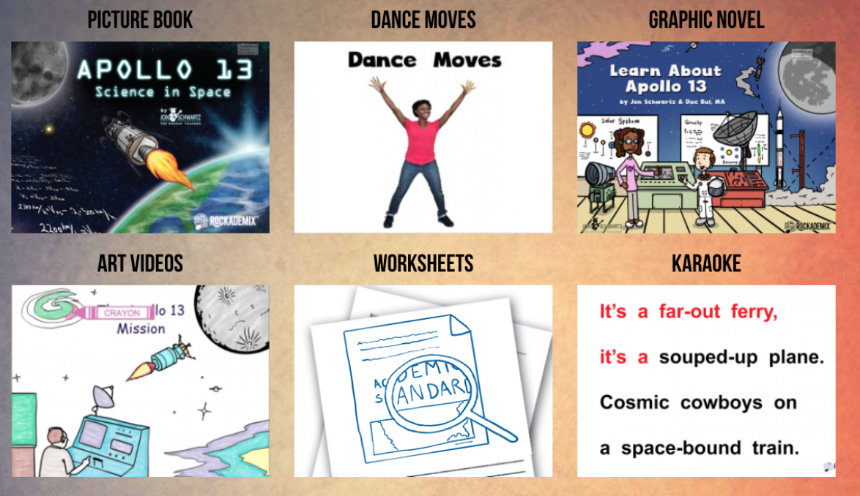
My refined method: (See on Website)
All original material designed to teach Gr. 5 CCSS Science Standards

Slide 15
Apollo 13
By Jon Schwartz www.rockingteacher.com
It’s a far out ferry, it’s a souped-up plane
Cosmic cowboys on a space-bound train
Liquid filled fuel tanks, pushing 60 tons
A quarter-million miles from the 3rd stone from the sun
The seventh manned mission flying to the moon
Sent to see a crater in a rocketship cocoon

Slide 16
Apollo 13
By Jon Schwartz www.rockingteacher.com
Houston there’s a problem, we just heard a rumble
Quick, check the voltage, and button up the tunnel
A jolt rocked the sensor, the temperatures unstable
Check the cabin pressure, and fasten up the cables
Science and robotics and the latest aeronautics
Helped them fix the problem with everybody watching

Slide 17

You Can Do This! *
1. Find some NGSS standards you want to teach.
https://www.nextgenscience.org/search-standards
Gravity…..5-PS2-1 Motion and Stability: Forces and Interactions
Plan and carry out tests to meet constraints of materials, time, and cost…..3-5-ETS1 Engineering Design
Energy in animals’ food is used for body repair…..PS3.D: Energy in Chemical Processes and Everyday Life
2. Find a song that has SOME references to the standards that will help you SUPPLEMENT your teaching of the subject.

Slide 18
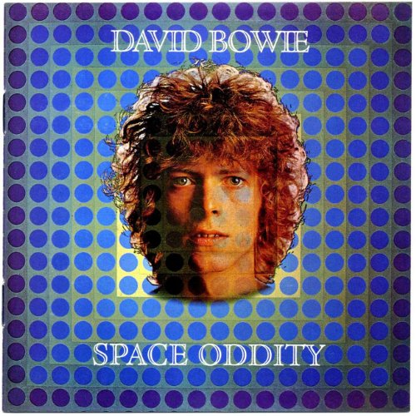
Use David Bowie’s “Space Oddity” to Teach 5th Grade NGSS
Video with lyrics https://youtu.be/9_M3uw29U1U
Ground Control to Major Tom
Take your protein pills, put your helmet on
(Energy in food is used for body repair)
"This is Major Tom to Ground Control
I'm stepping through the door
And I'm floating in a most peculiar way
(Gravity)
Ground Control to Major Tom
Your circuit's dead,
there's something wrong
Can you hear me major Tom?
(Plan and carry out tests to meet
constraints of materials, time, and cost)
Full lyrics
https://www.google.com/search?q=space+oddity+lyrics&source=lnms&sa=X&ved=0ahUKEwia7rLCpebXAhWHxlQKHZOPCtcQ_AUICSgA&biw=1172&bih=705&dpr=1.75

Slide 19

Find a standard
1. Find some NGSS standards you want to teach.
MS-PS1-4. Develop a model that predicts and describes changes in particle motion, temperature, and state of a pure substance when thermal energy is added or removed.
The changes of state that occur with variations in temperature or pressure can be described and predicted using these models of matter.
https://www.nextgenscience.org/pe/ms-ps1-4-matter-and-its-interactions

Slide 20
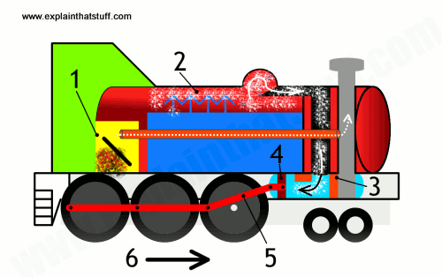
Find a song related to that standard
2. Find a song that has SOME references to the standards that will help you SUPPLEMENT your teaching of the subject.
MS-PS1-4. “changes in particle motion, temperature, and state of a pure substance when thermal energy is added or removed.

Slide 21
The Monkey and the Engineer
The Monkey and the Engineer by Jesse Fuller
Once upon a time there was an engineer.
Drove a locomotive both far and near.
Accompanied by a monkey that would sit on a stool
Watching everything the engineer would do
Big locomotive right on time, big locomotive coming down the line.
Big locomotive No. 99, left the engineer with a worried mind.

Slide 22
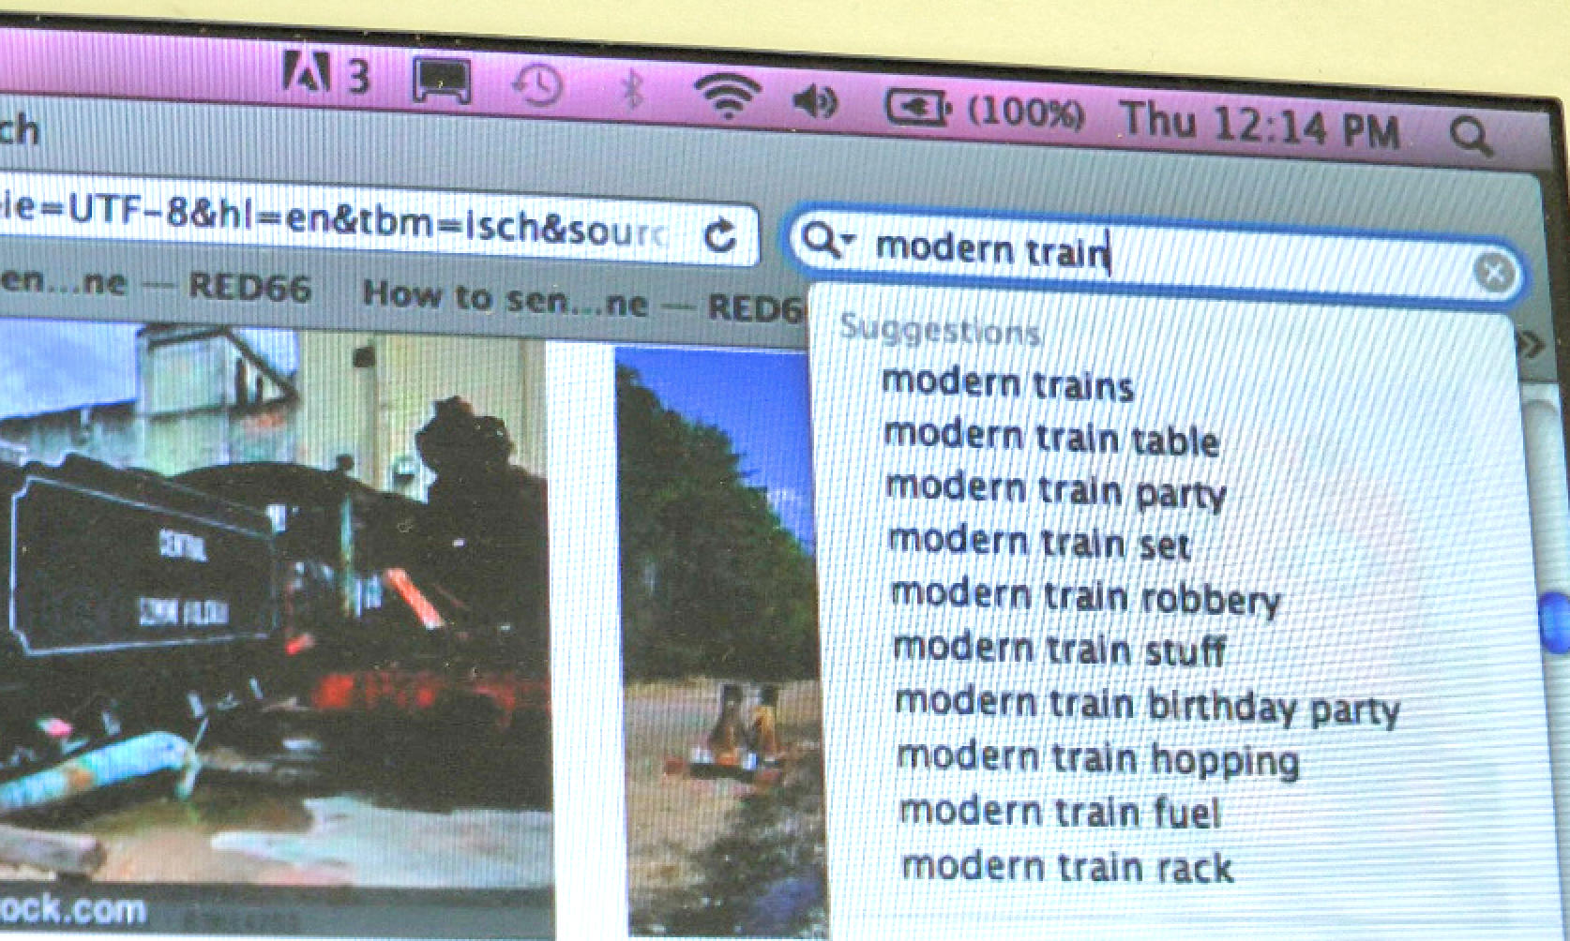
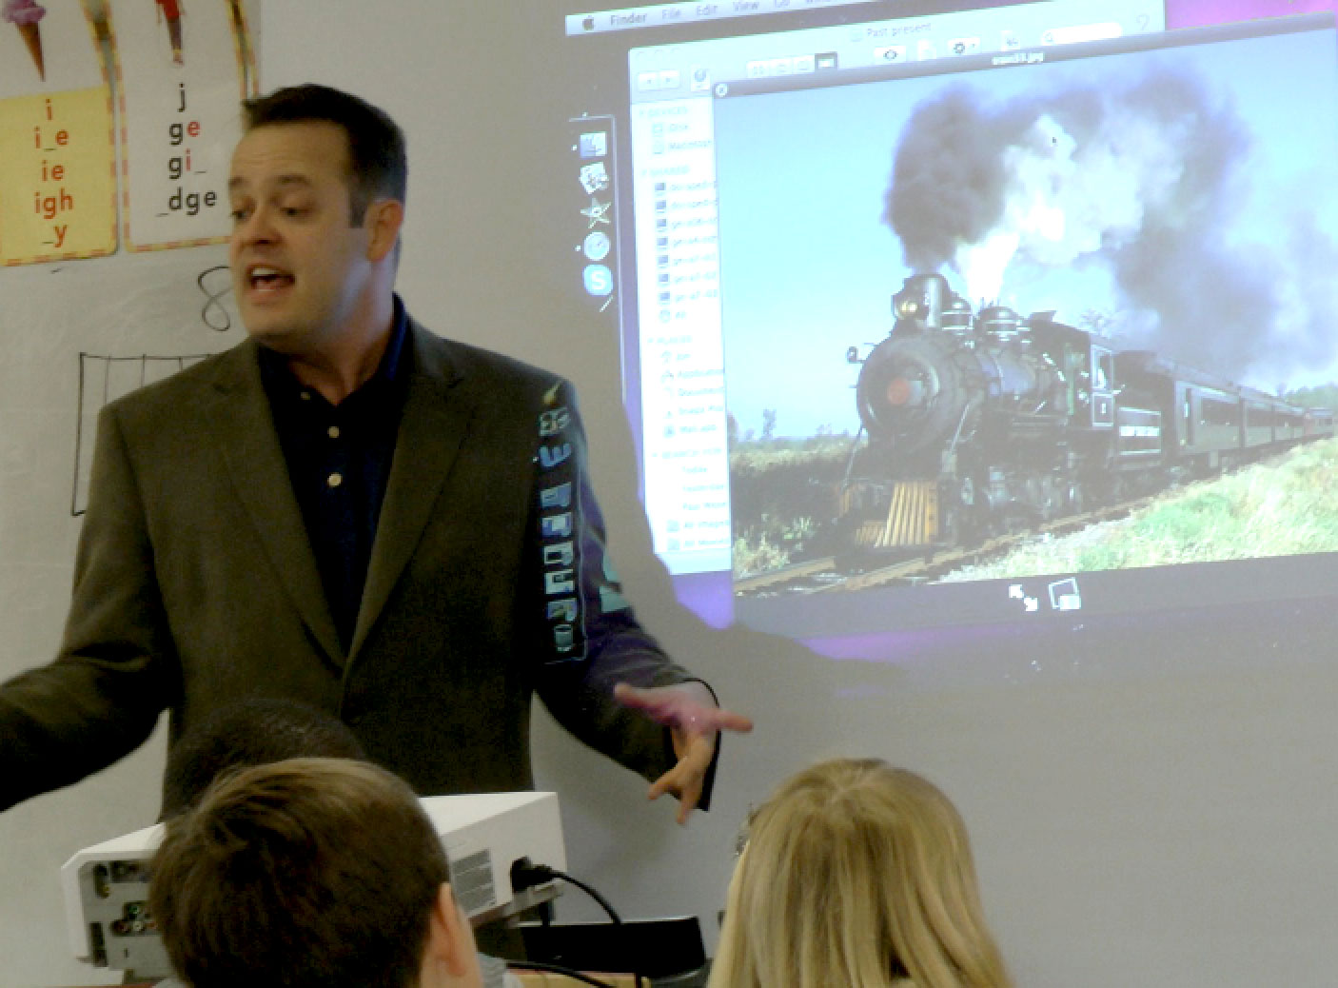
Use song to lean the subject
2. Do guided internet research on the topic to teach the subject matter.

Slide 23
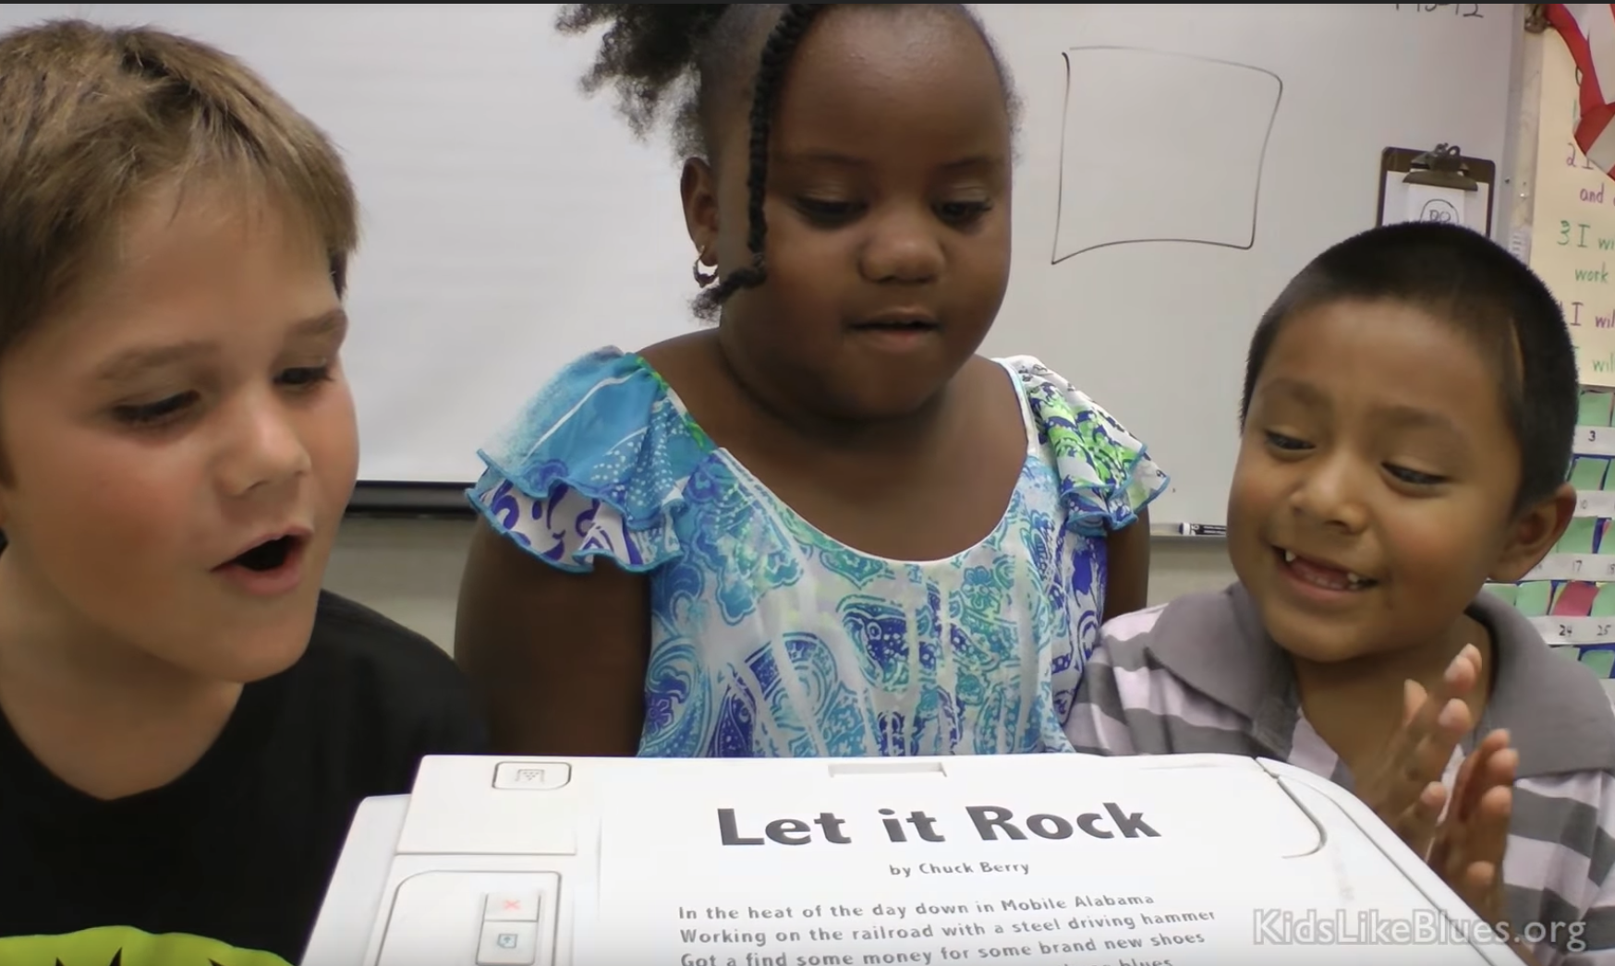
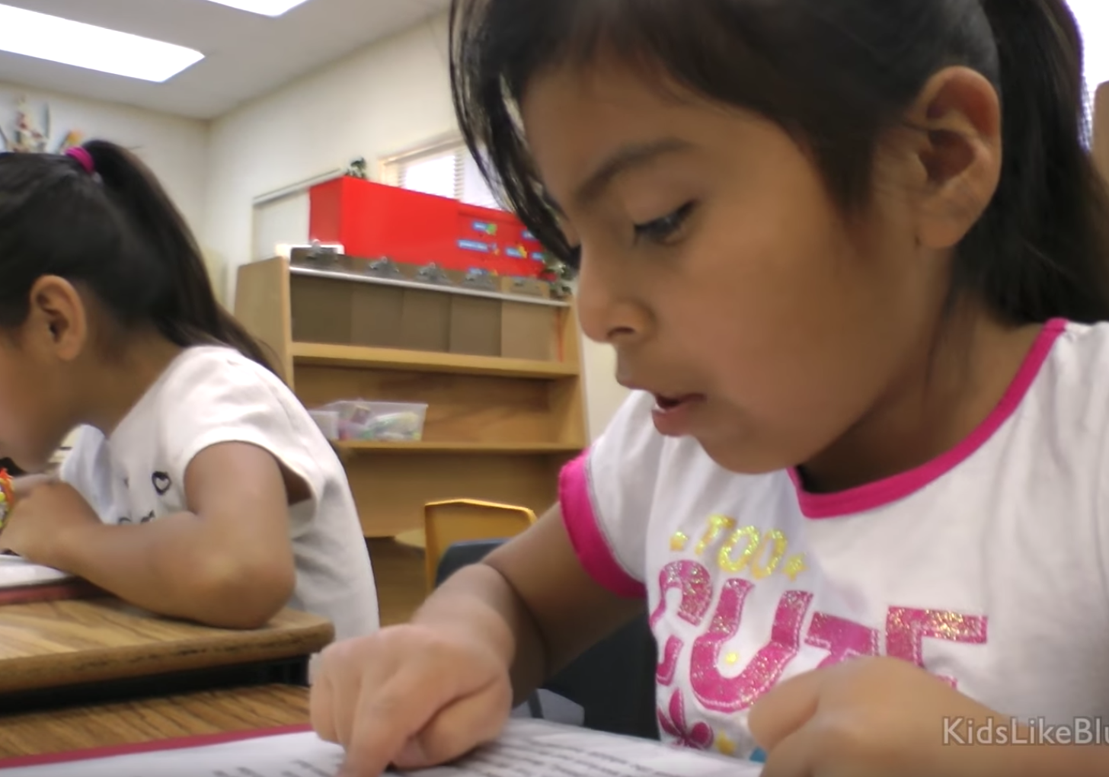
Read and sing the song
3. Give them the song and have them practice it at different speeds

Slide 24
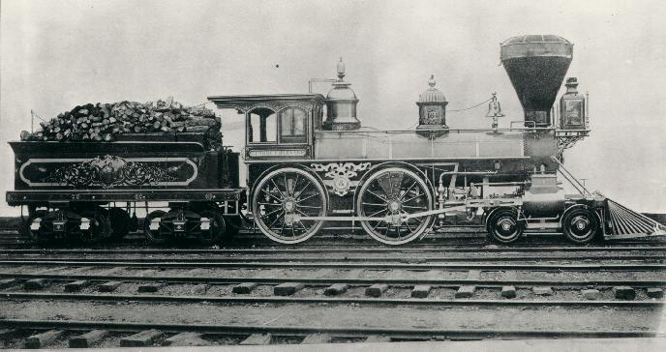
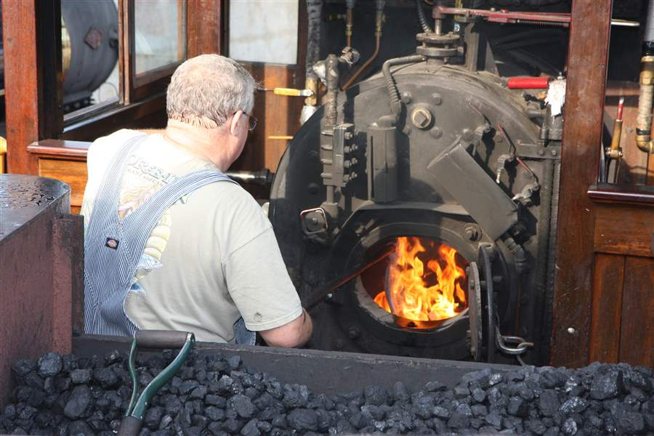
Find images
4. Find imagery in song that relates to the standard

Slide 25
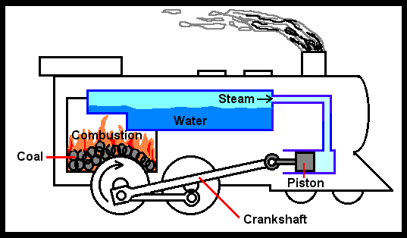
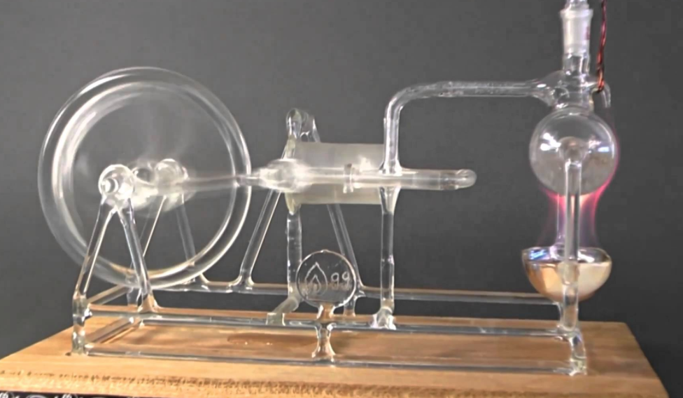
Connect images to standard
5. Explain how the imagery relates to the standard
“When the solid coal is burned, it converts the water into a gas called steam, which pushes the pistons that makes the wheels turn”
https://www.youtube.com/watch?v=73txXT21aZU

Slide 26
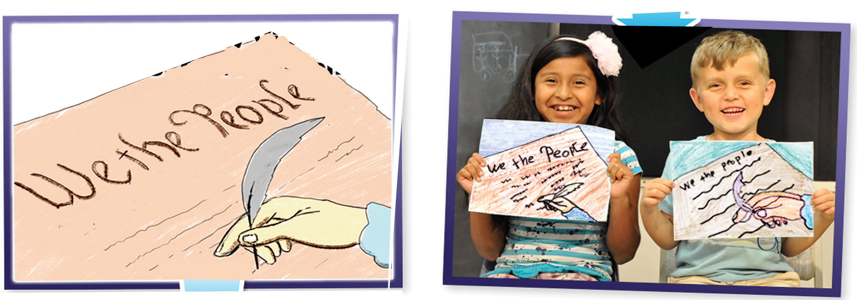
Make song related art
6. Display an image from LCD projector onto whiteboard, trace, students follow

Slide 27
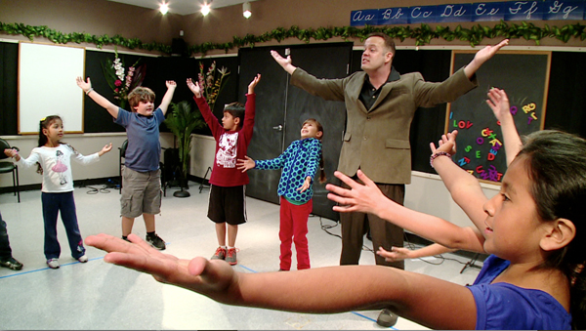
Dance moves for the song
6. Help kids make up dance moves for song related to the meaning.

Slide 28
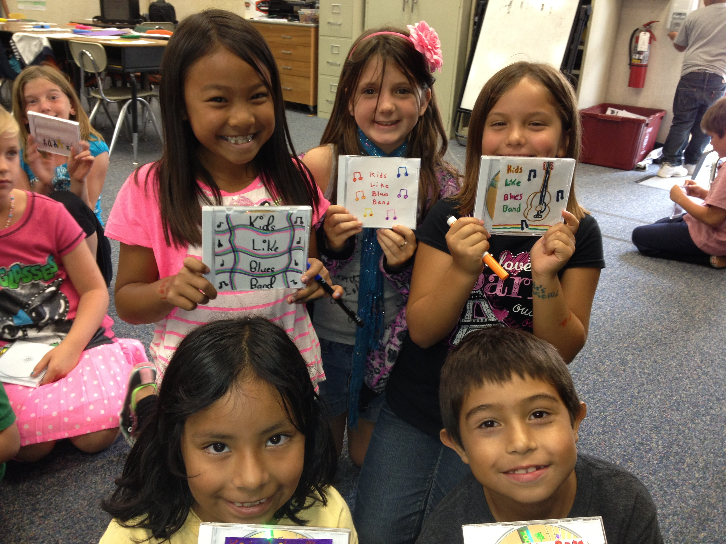
Make a CD of them singing
7. Record them singing on your phone and make CD’s for the kids

Slide 29
Jon Schwartz’s Rockin’ Teacher Website
For any questions or more information, email or call me, and please follow me on:
Facebook https://www.facebook.com/therockingteacher
Twitter https://twitter.com/TeacherJonRox
LinkedIn https://www.linkedin.com/in/jon-schwartz-9472ba9
Thanks so much again for attending!
Jon Schwartz
http://rockingteacher.com
jon@rockingteacher.com
760-712-7778

